Slide 1
We warmly welcome you to Reception
Part of Kinderley Primary School’s Early Years Foundation Stage Unit

Slide 2
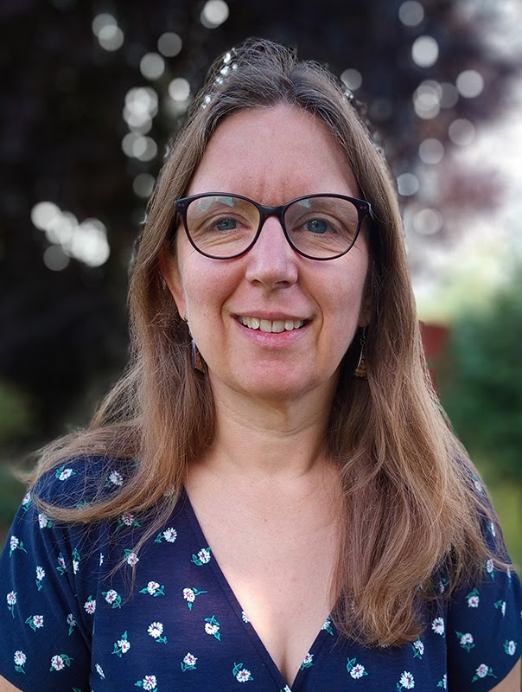
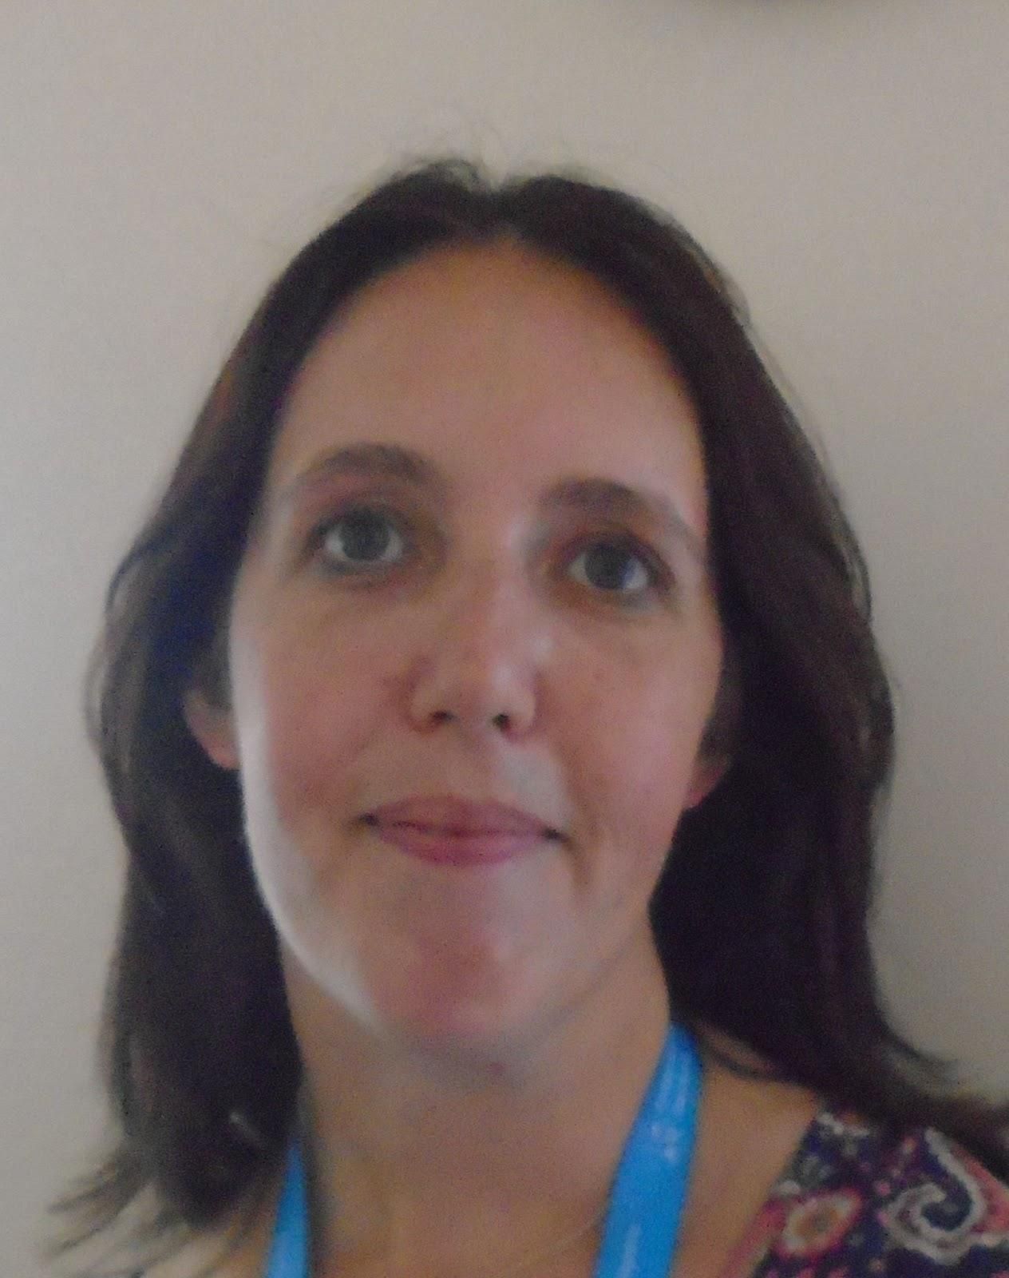
Starting in Reception
At Kinderley we know how difficult it can be when your child starts a new phase in their life. Starting Reception is an exciting new adventure we hope this booklet answers some of your questions and eases any worries you may have.
Firstly we would like to introduce some of the adults you will meet at Kinderley.
Mrs Scullion Mrs Nicholson Mrs Doe
Head Teacher SENDCO Class Teacher

Slide 3
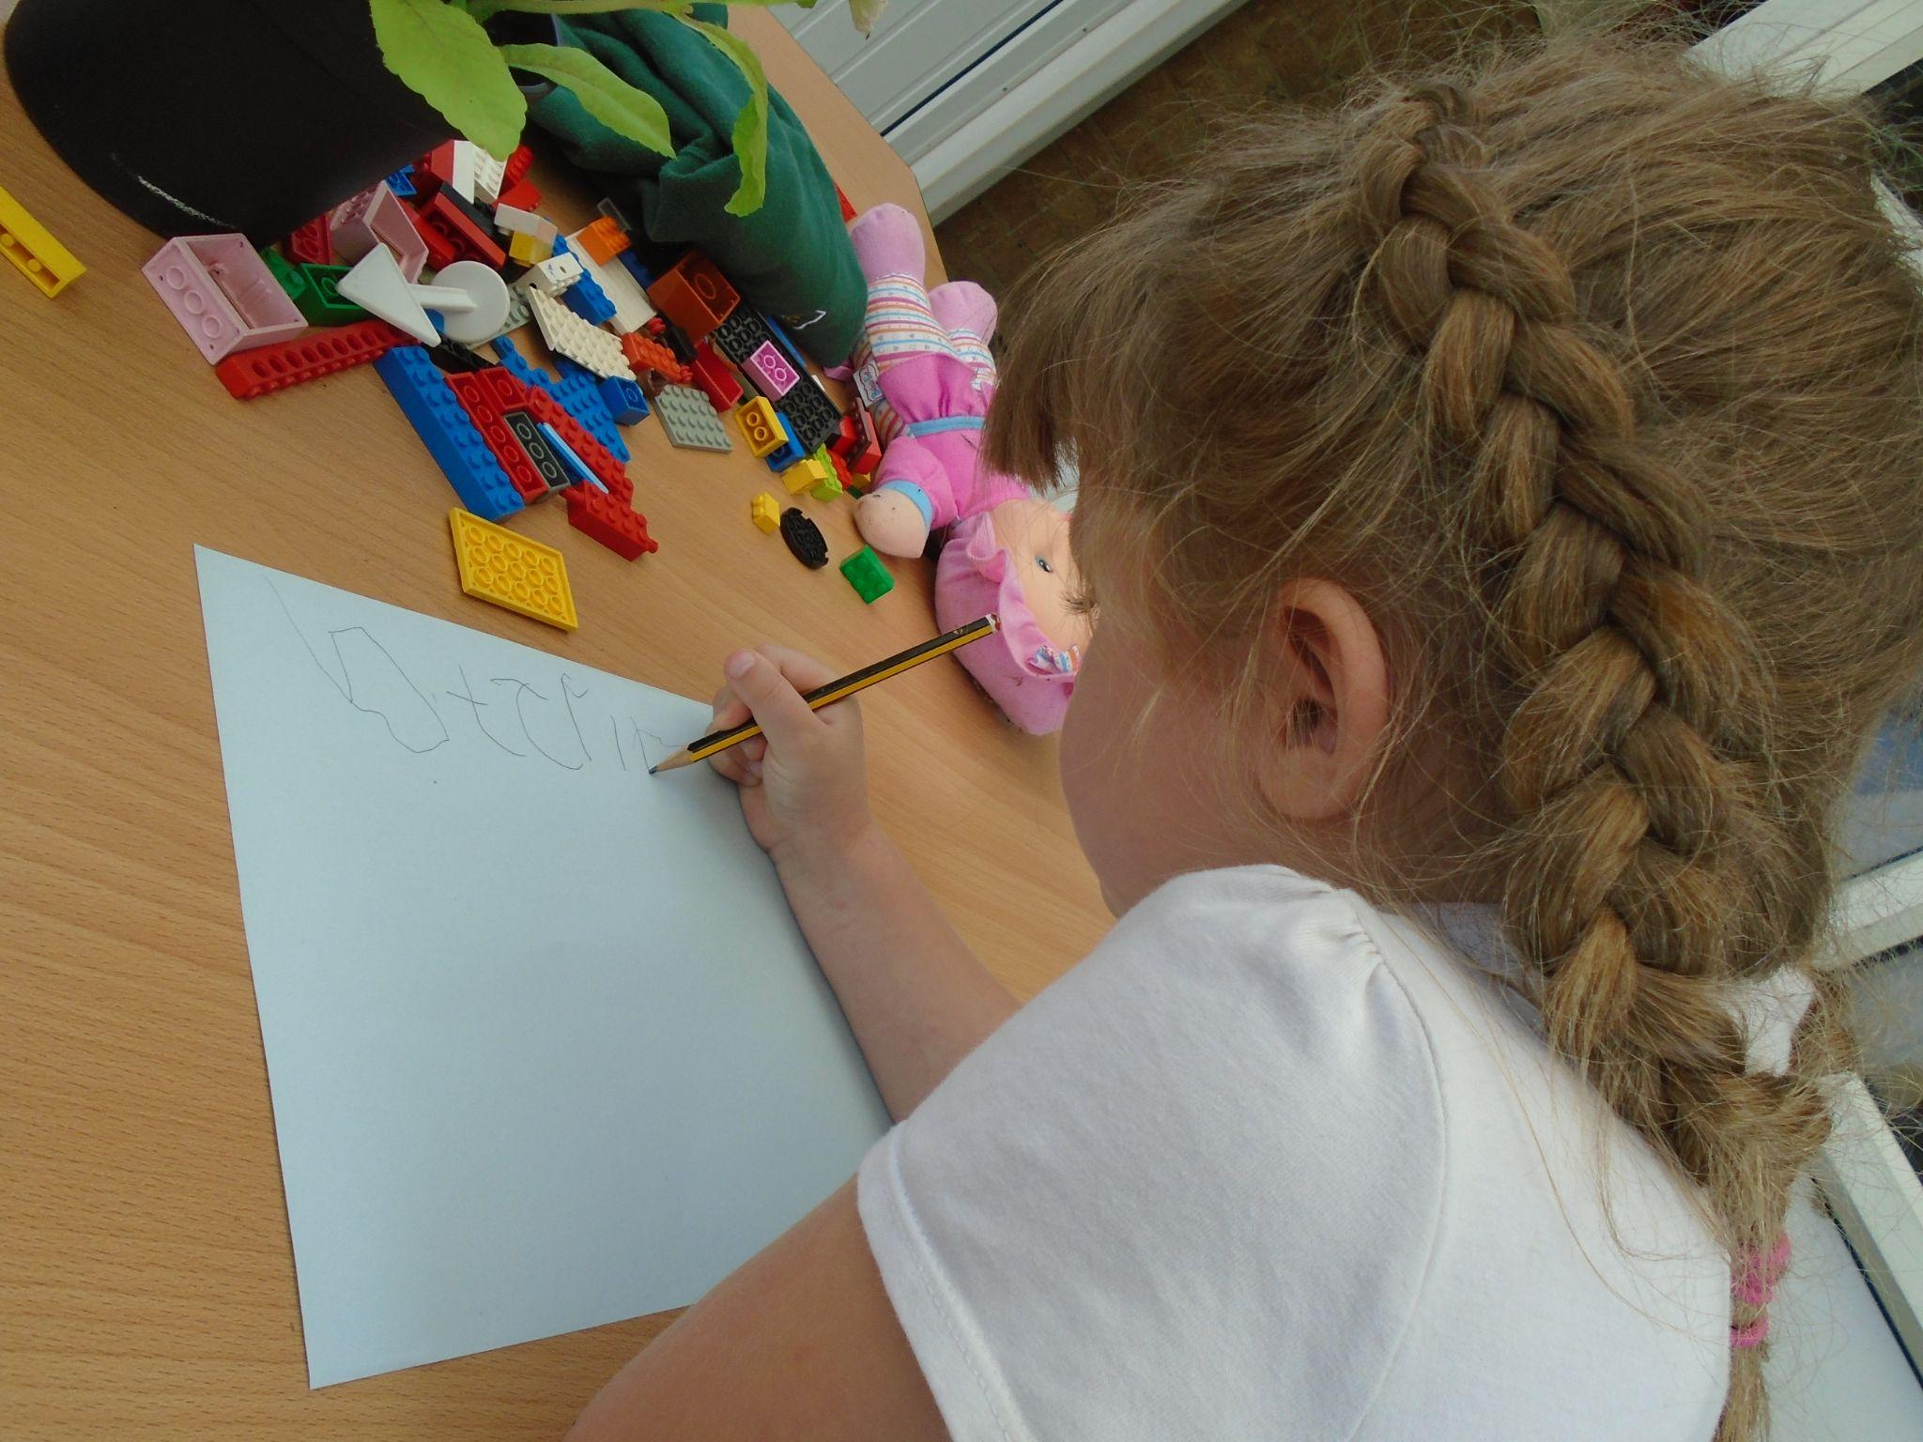
What will my child experience during the Reception Day?
Once the children are attending full days, the timetable will consist of:
A Read, Write Inc (RWI) phonics session
Rolling snack table
Freeflow activity time during which your child may work in a small group with either the teacher or teaching assistant
A maths teaching session
Physical activities including yoga, dough disco and PE
Once a week the children will attend a forest school session led by Mrs Doe

Slide 4
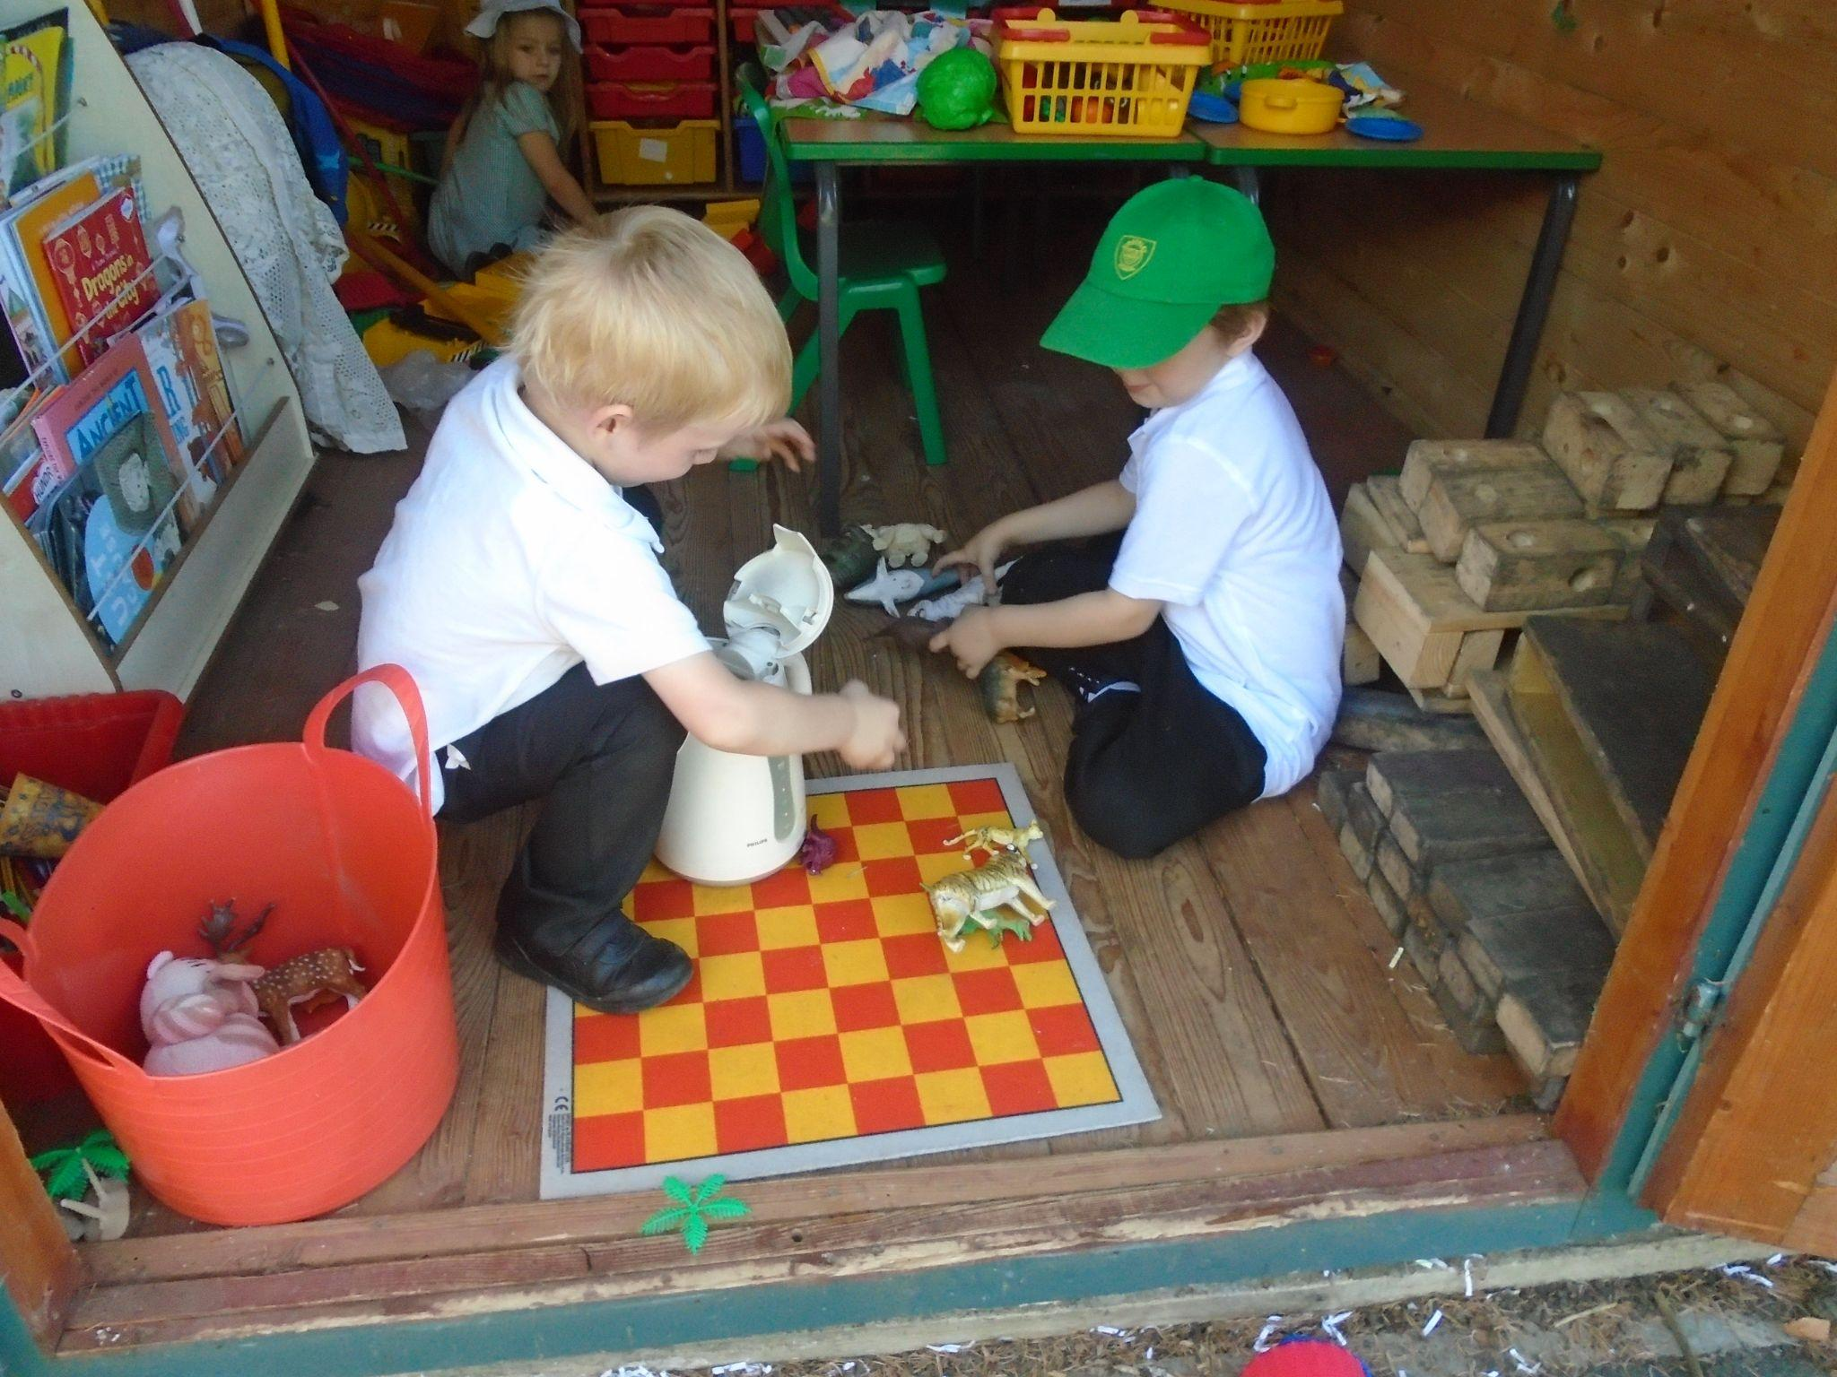
What is the foundation stage unit environment like?
The unit provides activities and resources for two to five year olds. We have a carpet base where large group learning activities take place as well as a small room that provides a quieter small group learning space which will enable children to fully engage and focus on the learning activity without distractions. The remainder of the environment is divided into areas. Each area offers a different variety of learning experiences and challenges for the children.
These areas include a home role play area, mark making area, maths area, construction area, creative area, a reading area and an investigation area. These areas will have resources that are continuously available as well as being enhanced with further resources to support the children’s interests.

Slide 5
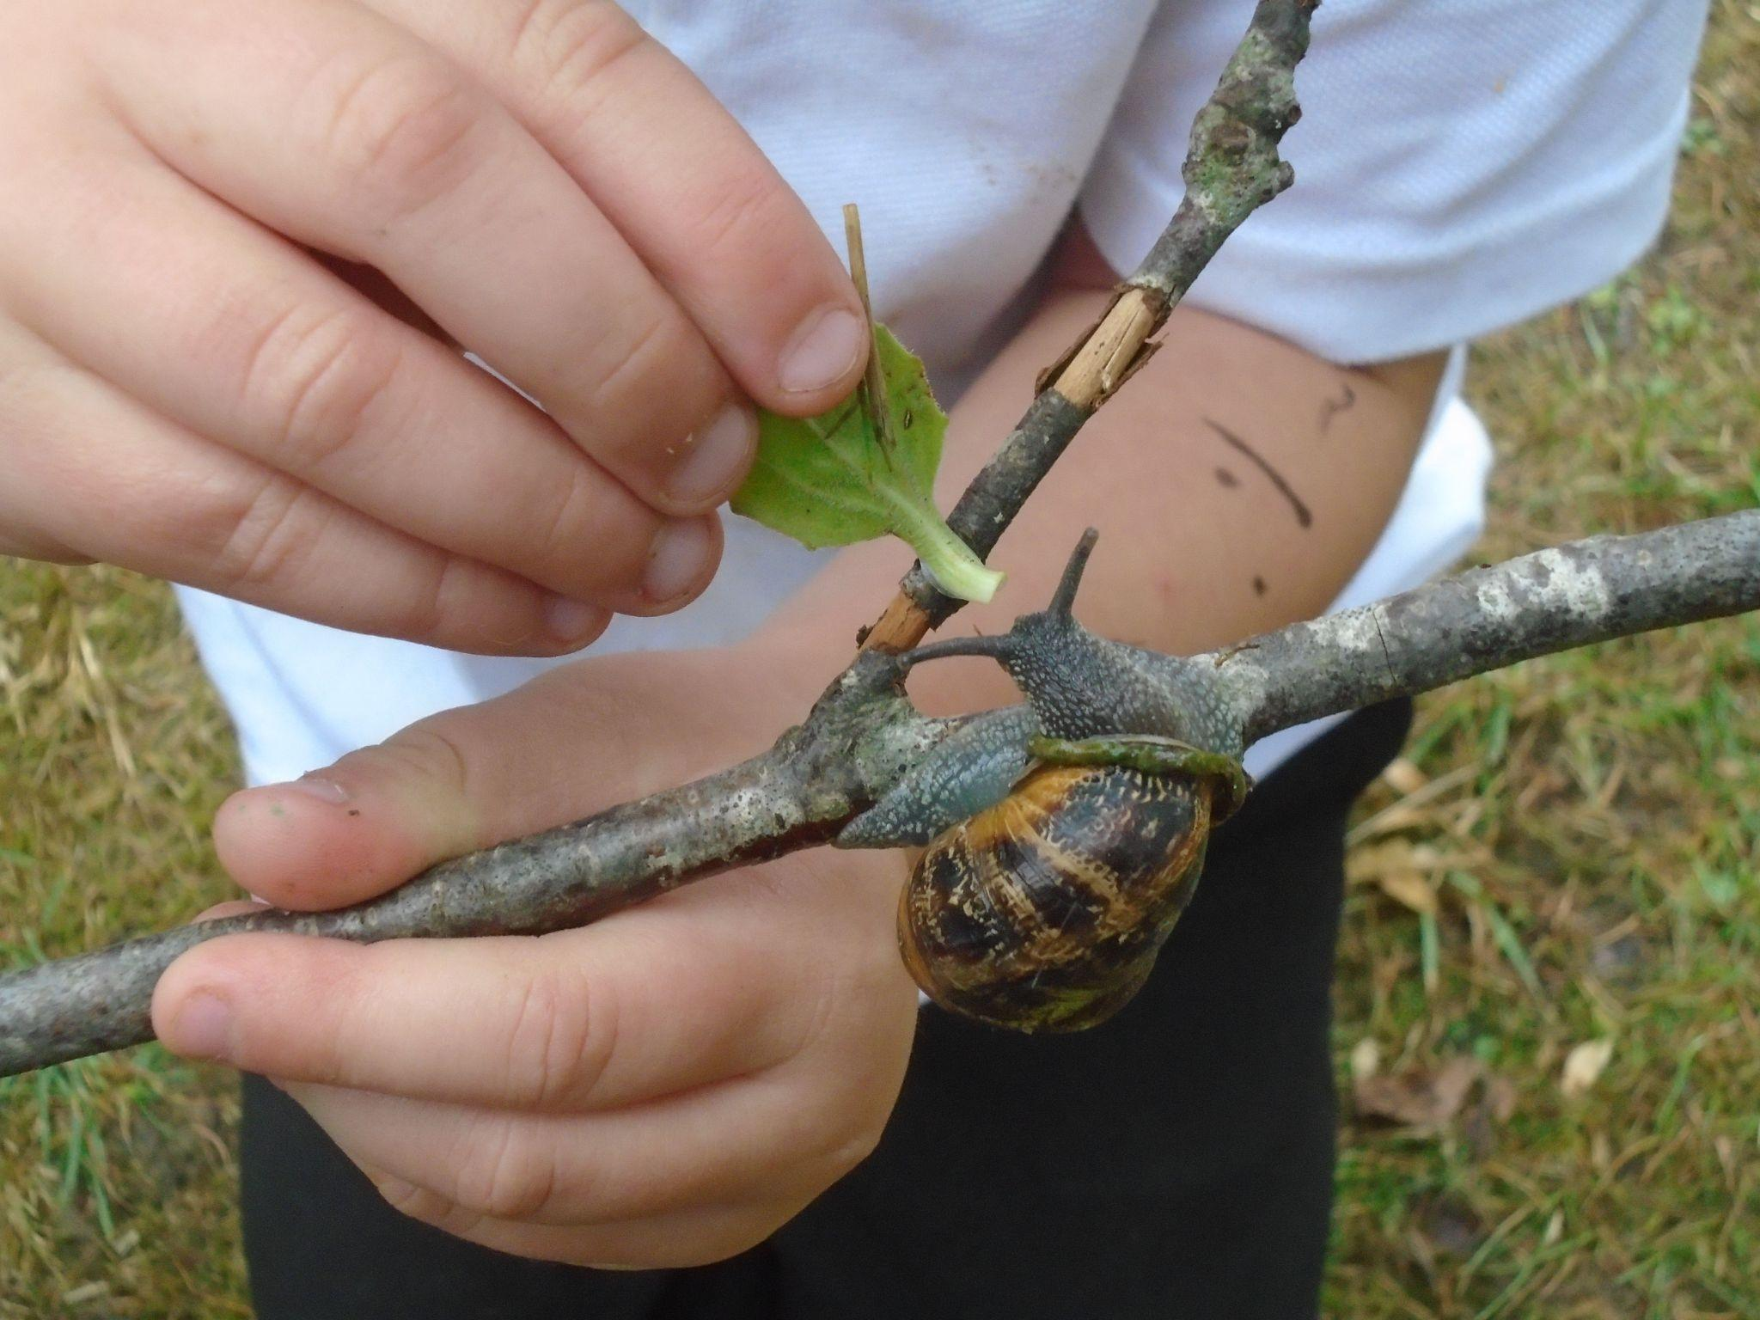
Will my child spend time outdoors?
At Kinderley, we consider the outdoor environment a classroom where learning and teaching can take place in a different way to that indoors. We are lucky to have two different spaces for the children to explore, the first provides a more physical movement orientated environment and the second a more natural exploration environment.
Your child will be able to access a variety of activities including sand and water play, climbing frames, mud kitchen area. There are many loose parts (objects that can be used for anything) both large and small to support the children’s explorations, for example planks, tyres, pine cones and shells.
Every Friday afternoon the whole unit will attend forest school which
will enable them to develop a different set of skills and learning
experiences.

Slide 6
What should my child wear to school?
The school uniform at Kinderley consists of either a white or yellow polo shirt, grey skirt, pinafore or trousers (shorts in the Summer term), green jumper or cardigan, black school shoes (not trainers). After Christmas, please provide your child with a PE kit to keep at school. This should consist of a white t-shirt, black shorts or jogging bottoms and plimsolls. Your child will also need a pair of wellies to be left at school. You never know when you might need to jump in a muddy puddle or two! It is also helpful to have a set of spare clothes just in case.
We have aprons and all on one outdoor suits to protect your child’s clothes however sometimes accidents do happen. If your child comes home messy and happy then they have had a great day at school.
Please help us by ensuring that all of your child’s clothes and shoes are clearly labelled.
Jewellery should not be worn to school for safety reasons, a small stud earring is permitted.
School bags:
A school book bag can be obtained via the office, these are the perfect size for books,
a snack and some spare clothes.

Slide 7
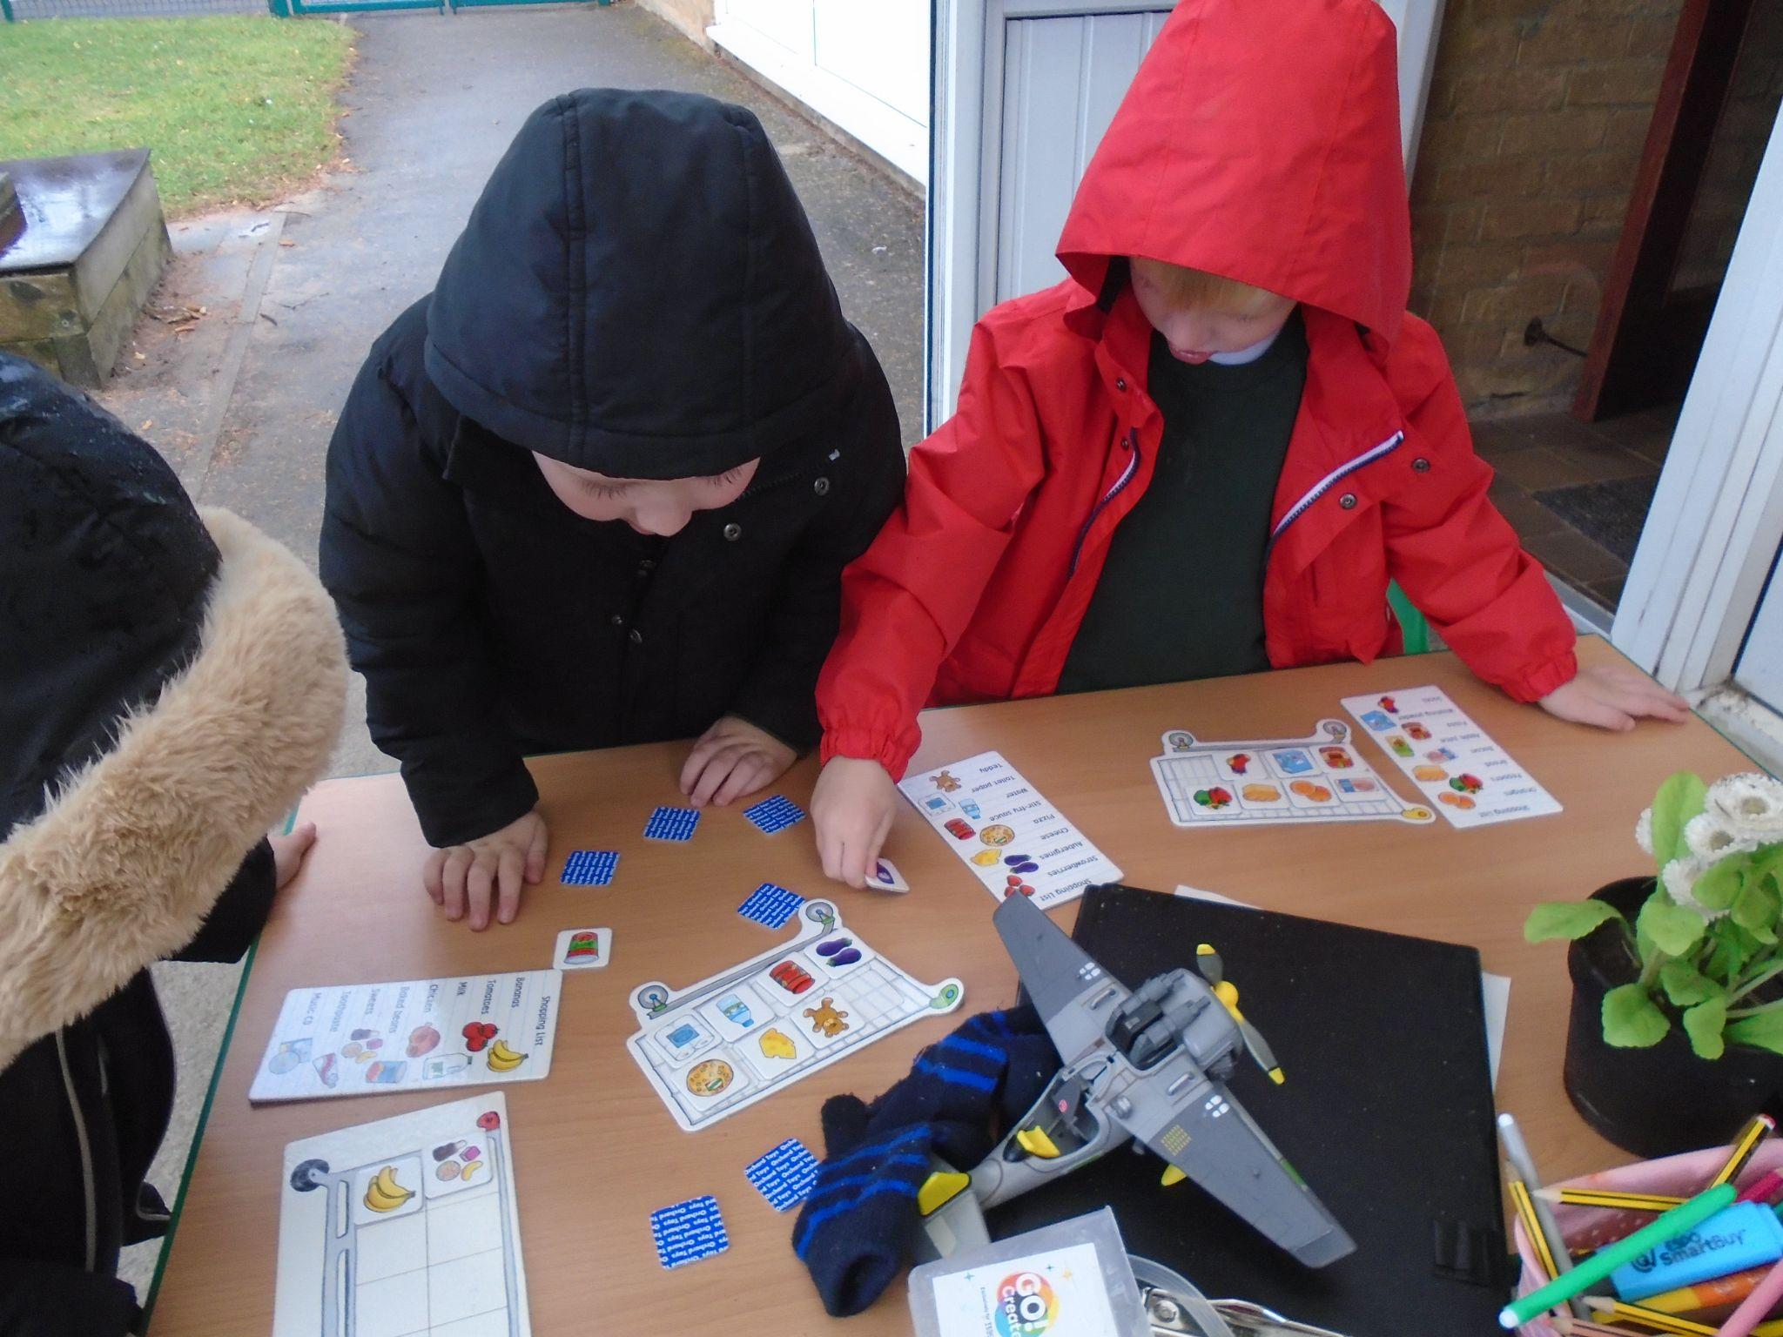
How and when will my child start school?
At Kinderley we aim to provide you and your child with a smooth transition to Reception. We wish to get to know you as quickly as possible. During your child’s first week they will attend half days, finishing at 12noon; this will enable staff to meet with a couple of parents each day to discuss their child and find out all about them as a family.
After this week children will attend full time, arriving at 8.45am and being collected at 3.15 p.m.

Slide 8
What will happen on the first day?
We will greet you and your child at the bottom of the ramp. Your child will then walk up and into the building where they will be greeted by an adult. They will hang up their bag and coat, be supported to find their name and add it to the door register and then join their friends on the carpet to sing songs. Throughout the morning the class will be introduced to the new environment and then allowed to choose their own activities inside or outside.
At the end of the morning an adult will open the gate. Please wait along the fence at the bottom of the ramp. We will then call for your child to be let out to greet you.

Slide 9
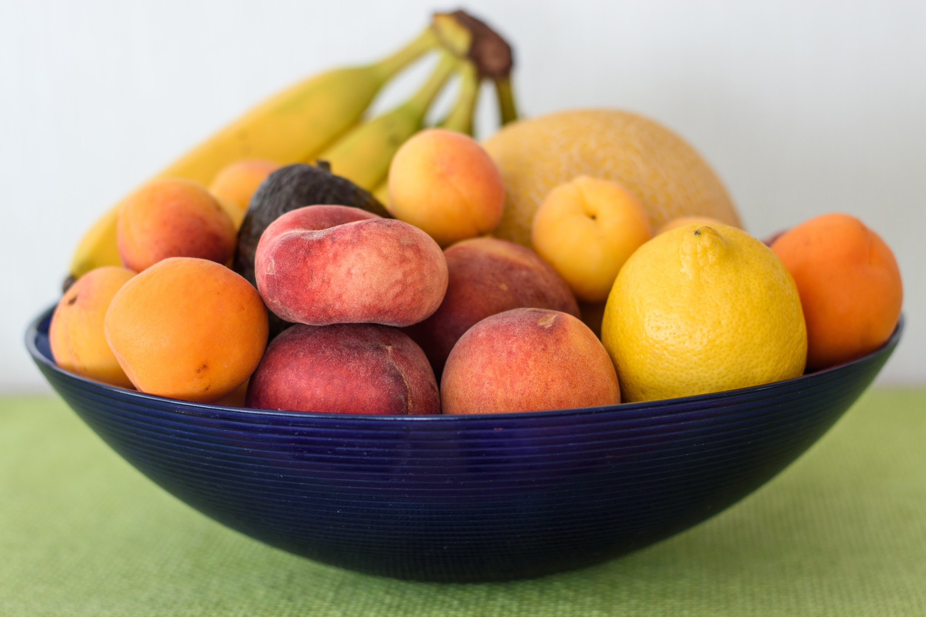
What can my child eat and drink at school?
Water Bottles and Snack:
As a healthy school we will provide your child with either water or milk. We will supply a named school water bottle which will be washed every day and refilled with fresh water in the morning and throughout the day as necessary. Milk will be available on the snack table with cups.
You are welcome to provide your child’s own water bottle to leave at school.
Snack will usually consist of fruit or vegetables, however you are welcome to send your child’s own healthy snack to school for them to eat (fruit, vegetables or cheese). There may also be cereals or toast on some days. Snack is available for most of the day as we find that children can then have food when they feel hungry. Adults will remind them throughout the day too.
Lunches:
School lunches are available free or you are welcome to provide a healthy packed lunch for your child. The children will walk across to the main school building for lunch in the hall.

Slide 10
How will you record my child’s progress?
Adults will be observing your child all the time, this does not mean that they will constantly be writing notes and taking photos. Observations are mainly mentally noted and recorded later if needs be. Special or Wow moments when your child has been trying something new or showing a new skill will be recorded on class dojo which will be shared with you.
Each term the adults will discuss whether or not your child is on track or not yet on track to achieve their age checkpoints from the development matters document. This then allows the adults to plan how to support your child the following term.
If the adults have concerns regarding your child’s progress, they will arrange a meeting with you to discuss them. You can also talk to the adults when you feel you need to. The best time to do this is at the end of the day once all children have been dismissed or if you would like to arrange a longer meeting please contact the office.
There will be two progress meetings (parent consultations) during the year, one in the autumn term, one in the spring term and a written report in the summer term.

Slide 11
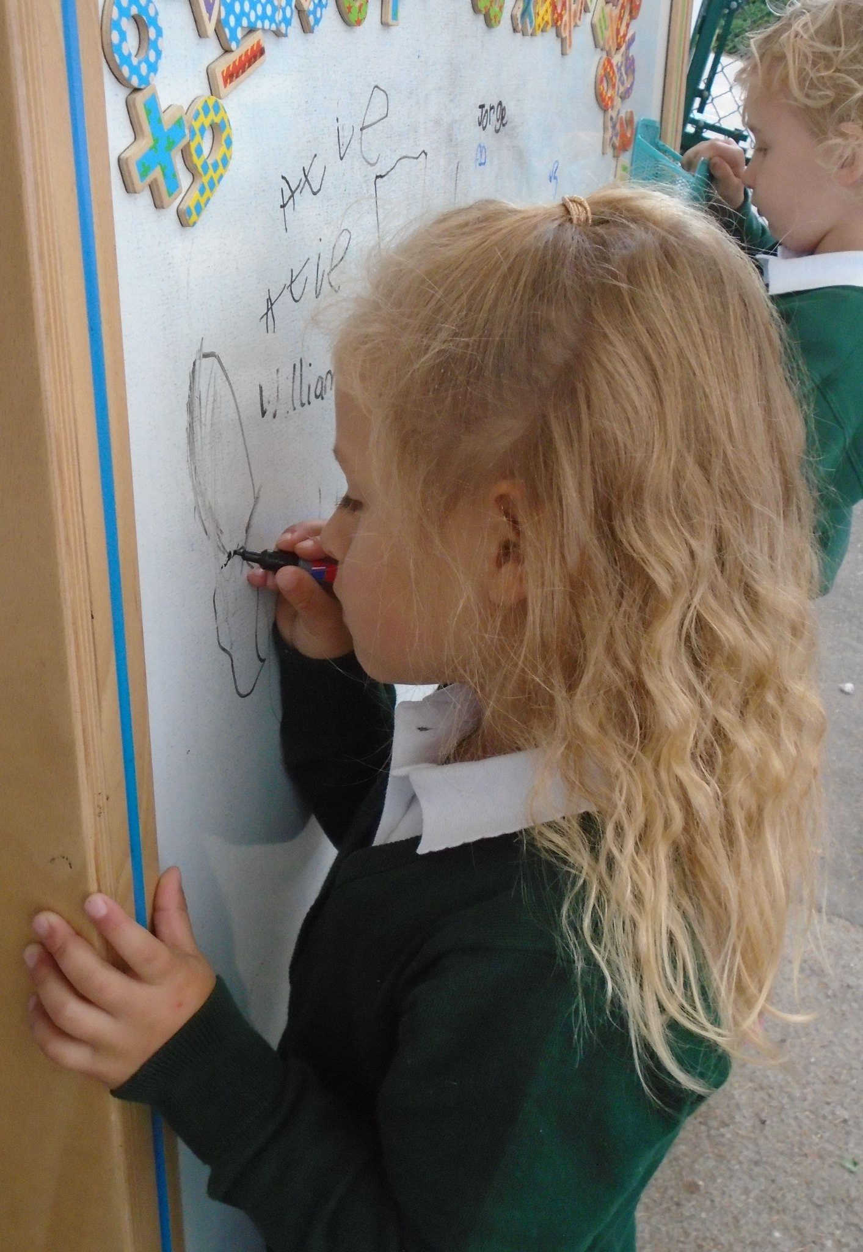
How is my child’s learning recorded?
Adults will save, copy or photograph some of your child’s learning, particularly those which show progression, in their special book or digitally through class dojo.
You will be invited to join class dojo and can download the app if you wish. Each time an adult uploads a photo or observation notes you will receive a notification. You can make comments about your child’s achievement.
We would also welcome and appreciate if you could upload your own photos and videos from home. This will provide a more holistic knowledge of your child’s progress across the seven areas
of learning.
You can also write a wow moment slip (these will be sent home during the first week)
that we can share with the class to celebrate their achievement or special event.

Slide 12
How will I know what my child will be learning?
Each half term we will send out an overview of the learning. This will also include some learning ideas and activities you could try at home to support that taking place in school. Adults will also add regular updates via class dojo.
Phonics will be taught following the Read, Write, Inc programme. Each day a QR code and link will be sent home that will take you to a video clip of the day’s phonic sound/learning. Please take five minutes to watch this with your child.
If you have questions regarding learning please ask an adult at the end of the day or via class dojo.

Slide 13
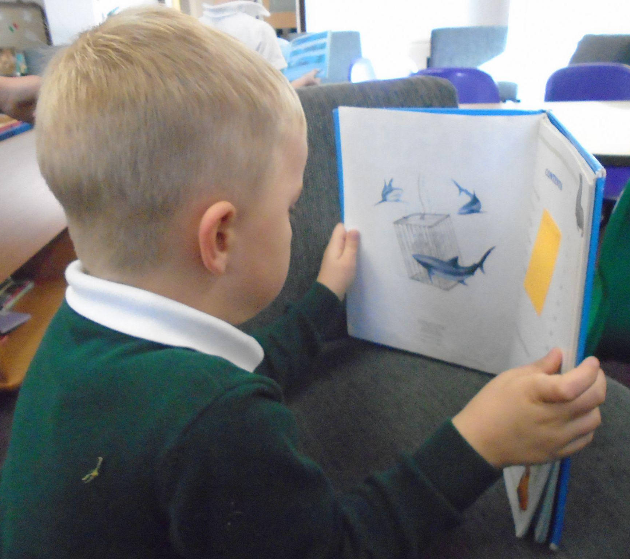
What will my child learn about?
Your child will still be experiencing learning across the seven areas of learning of the Early Years Foundation Stage (EYFS). This will be at a different level to the 2-4 year olds.
At the beginning of the Reception year your child will be assessed to form a baseline which will show what level they are currently at in reading, writing and maths. The adults in the unit will also observe your child to form a more detailed baseline across all area of learning. At the end of the year your child will be assessed again to see whether or not they meet the 17 Early Learning Goals.
We plan around topics and use the children’s interest to provide a rich and varied curriculum. All children develop at their own pace but with encouragement, support and opportunities, we at Kinderley believe they will reach their full potential.
Once the children have started to learn phonics they will begin to bring a reading book home, this will be fully readable. They will also have a reading record. We ask that you sign and date when you and your child have read at home in their reading record. Both the reading record and reading book should be brought into school everyday as we will be listening to them read throughout the week.

Slide 14
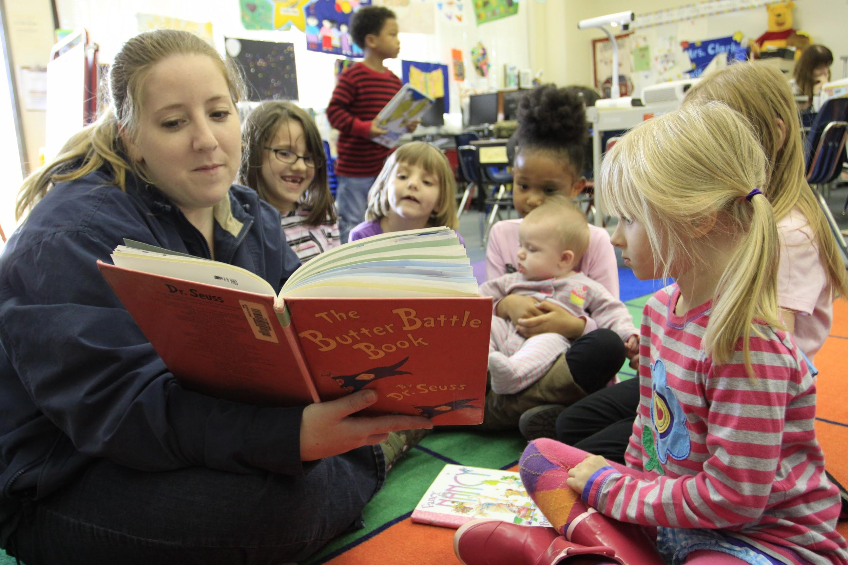
Are parents invited into school?
At Kinderley we know that parents are the children’s first teacher and want to keep you involved in their learning. We will invite you in for a special session each term that will be linked to the topic. It is also our intention to host a stay and play session each week for two children’s parents. You will be informed more about how to sign up for these once we feel all children are settled.
We will also hold various parent sessions to help you understand and support your child’s learning at home for example phonics and maths.
There will also be several whole school events throughout
the year that parents will be invited to attend.

Slide 15
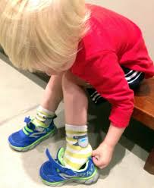
What should my child be able to do before they begin Reception?
At Kinderley we know that parents can sometimes worry that their child is not ready for school. Below is a list of skills we believe could be of benefit if your child can do them before starting school.
be able to recognise their name
be able to manage going to the toilet independently and wash their hands
be able to dress and undress themselves
be able to hold a conversation with another person
be able to use a tissue to blow their nose
be able to feed themselves using cutlery
be able to tidy away after themselves
to understand that they may have to wait for things they would like

Slide 16
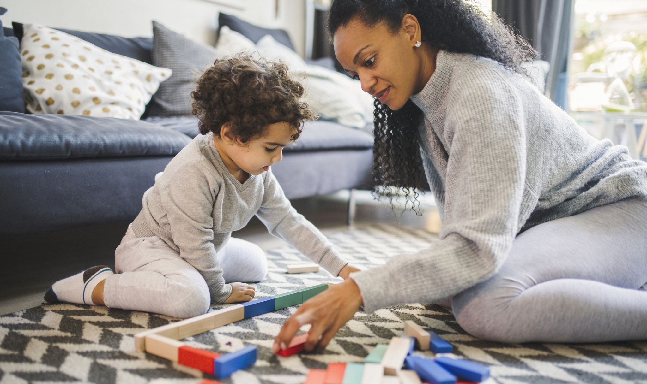
How can I help prepare my child for Reception?
Sing songs together
Talk together about everything
Be positive about school and answer any questions they have
Ask them questions that require more than a yes or no answer
Read together
Build on what your child says e.g. ‘a car’, you reply ‘yes I see a blue car’
Talk about feelings and emotions, help your child to name them
Support them in becoming independent in their own care, including putting on and doing up their jacket, putting in their shoes and washing their hands.
Play games together

Slide 17
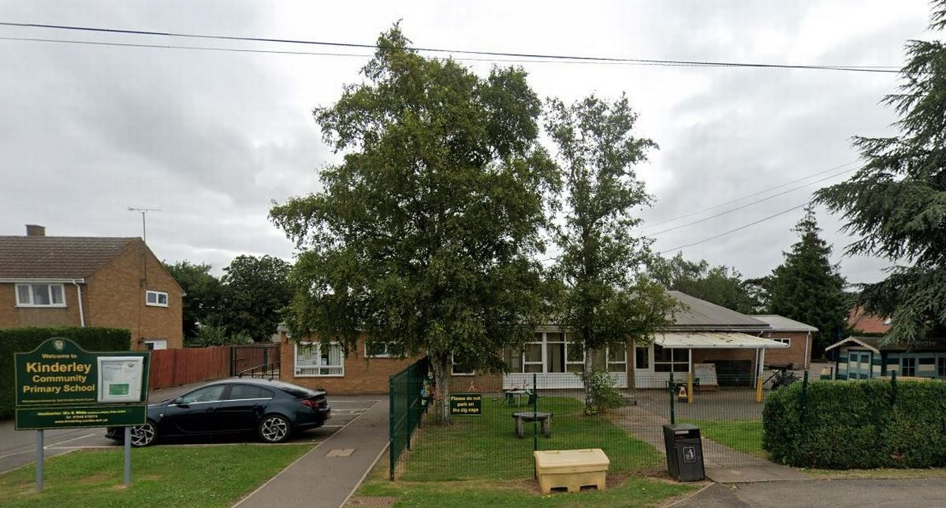
I have more questions how can I contact you?
If you have more questions or comments please contact the school office:
Email: office@kinderley.cambs.sch.uk
Telephone: 01945 870374
or call into the office in person

